Slide 1
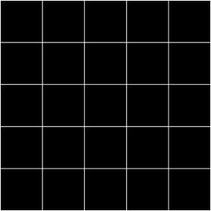


Open Minds Club
AI School Iteration 2.2
Linear Regression
By BOULGHERAIF Fatma Zohra
<h4>
</h4>

Slide 2

Open Minds Club
01. What is Regression?

Slide 3
Open Minds Club
01. What Is Regression?
👉 Regression = Predicting a continuous number as output
Examples:
  🏠 Predict house prices
  🌡️ Predict tomorrow's temperature
  🎓 Predict a student's exam score
  📈 Predict monthly sales

Slide 4
Open Minds Club
02. Simple Linear Regression

Slide 5
Open Minds Club
02. Simple Linear Regression
Key idea: Find a straight line that best describes the relationship between one input and one output.
ŷ = β₀ + β₁x
| ŷ: Predicted value (dependent variable)
| x: Input feature (independent variable)
| β₀: Intercept — where the line crosses the y-axis
| β₁: Slope — how much ŷ changes per unit of x
Why simple? Only one independent variable
Why linear? The equation is a linear function of x

Slide 6
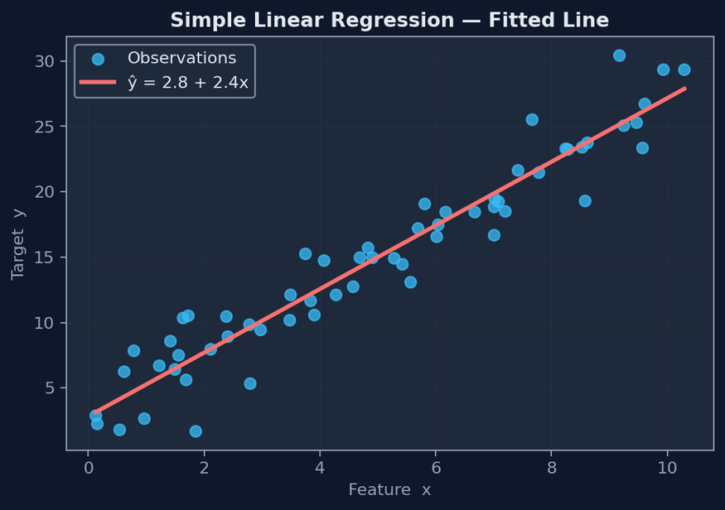
Open Minds Club
02. Simple Linear Regression
There are infinite possible lines. We need a way to pick the best one.

Slide 7
Open Minds Club
03. Parameter Optimization

Slide 8
Open Minds Club
03. Residuals
A residual is the gap between the actual value and what the model predicted.
residual = y - ŷ
📌 Rule of thumb
In supervised learning, the goal is always to minimize the gap between predicted and actual values.

Slide 9
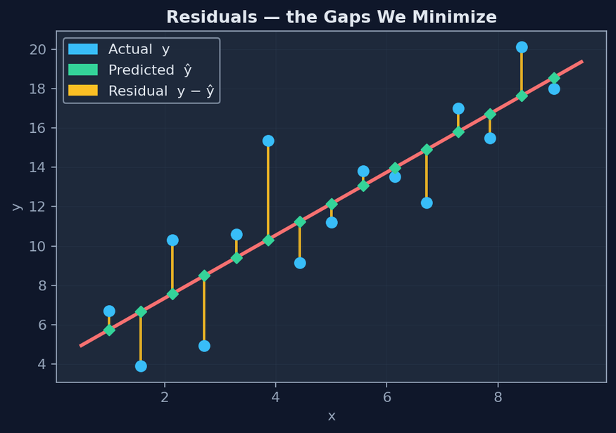
Open Minds Club
03. Loss function (MSE)
Mean Squared Error (MSE) = (1/n) Σ (yᵢ - ŷᵢ)²
- We square residuals so negatives don't cancel out positives
- We want this number as small as possible
=> Residual Sum of Squares minimization → leads to the best fit line

Slide 10
Open Minds Club
03. How Do We Minimize the Loss?
Ordinary Least Squares (OLS) | Gradient Descent
- A mathematical formula that solves for β directly - Closed-form, exact, fast for small datasets β = (XᵀX)⁻¹Xᵀy ✅ No iterations needed ❌ Expensive when data is very large | - An iterative algorithm — takes small steps downhill on the loss curve - Used in most ML frameworks under the hood ✅ Scales to large datasets Requires choosing a learning rate
Both methods find the same answer. OLS is exact, gradient descent is approximate but scalable.

Slide 11
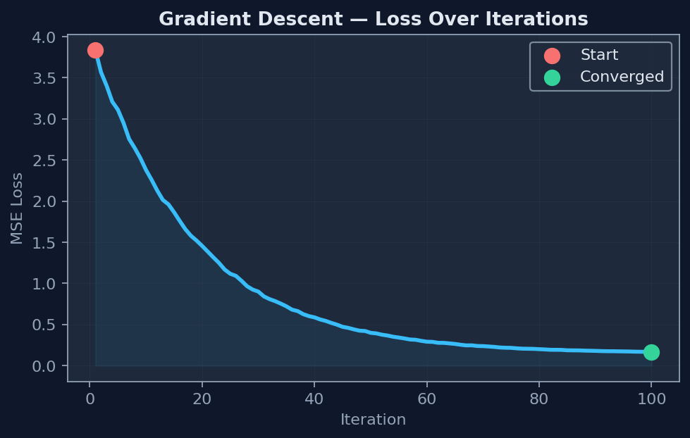
Open Minds Club
03. How Do We Minimize the Loss?
﻿@🕸️
￼
chhhox
﻿ ur m
Learning Curve

Slide 12
Open Minds Club
03. Gradient Descent
Step 1 — Forward Pass: compute the prediction
Given the current weights, run the model forward and compute ŷ:
ŷ = w₀ + w₁x₁ + w₂x₂ + ... + wₙxₙ
Then compute the loss:
J(w) = MSE = (1/n) Σ (yᵢ - ŷᵢ)²

Slide 13
Open Minds Club
03. Gradient Descent
Step 2 — Measure each parameter's contribution to the loss
For every weight wᵢ we need to know two things:
  Direction: does this value of wᵢ drive the loss up or down?
  Magnitude: by how much?
This is exactly what the gradient tells us:
∇wᵢ = ∂J / ∂wᵢ
> The gradient is the same concept as a derivative, the slope of the loss with respect to wᵢ at the current point.
> A positive gradient means wᵢ is pushing the loss up.
> A negative gradient means wᵢ is pushing the loss down.

Slide 14
Open Minds Club
03. Gradient Descent
Step 3 — Backward Pass: update every parameter
We want to reduce the loss, so we move each weight in the opposite direction of its gradient:
wᵢ(t+1) = wᵢ(t) − η · ∇wᵢ
| Gradient sign | Meaning | What we do |
| ∇wᵢ > 0 | wᵢ drives loss up | Subtract → reduce wᵢ |
| ∇wᵢ < 0 | wᵢ drives loss down | Subtracting a negative → increase wᵢ |
The learning rate η controls the step size, how aggressively we update.
Too large → overshoot the minimum. Too small → painfully slow convergence.

Slide 15
Open Minds Club
03. Gradient Descent
Step 4 — Repeat until convergence
We repeat steps 1–3 for many iterations. Each pass:
- Loss decreases (ideally)
- Parameters get closer to their optimal values
- Steps get smaller as we approach the minimum (gradient shrinks near flat regions)
We stop when the loss stops improving significantly → convergence.

Slide 16
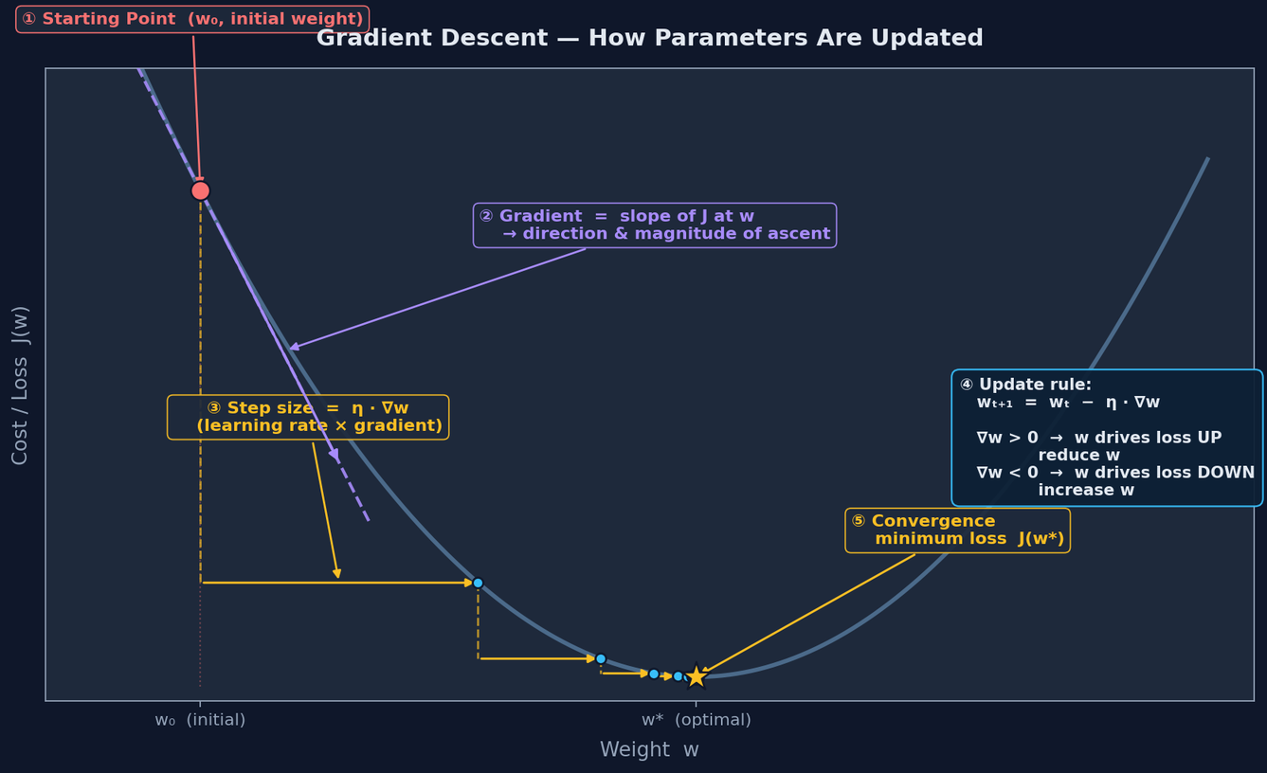
Open Minds Club
03. Gradient Descent

Slide 17
Open Minds Club
04. Multiple Linear Regression

Slide 18
Open Minds Club
04. Multiple Linear Regression
Key idea: Same concept, more input features.
ŷ = β₀ + β₁x₁ + β₂x₂ + ... + βₙxₙ
Example:
Predicting house price using:
  x₁ = size (m²)
  x₂ = number of rooms
  x₃ = distance from city center
Interpreting coefficients:
β₁ = 200 means: for every 1 m² increase in size, the predicted price increases by 200 (holding all other features constant).

Slide 19
Open Minds Club
05. Evaluation

Slide 20
Open Minds Club
05. Evaluation: RMSE
Root Mean Squared Error (RMSE)
RMSE = √MSE
- Same unit as the target variable (interpretable!)
- Penalizes large errors more heavily (due to squaring)
- "On average, my predictions are off by X units"

Slide 21
Open Minds Club
05. Evaluation: MAE
Mean Absolute Error (MAE)
MAE = (1/n) Σ |yᵢ - ŷᵢ|
- Average absolute error: simple and robust
- Less sensitive to outliers than RMSE
- "On average, I'm off by X, treating all errors equally"

Slide 22
Open Minds Club
05. Evaluation: R²
R-squared
R² = 1 - (SS_res / SS_tot)
Residual Sum of Squares: SS_res = Σ (yᵢ - ŷᵢ)²
Total Sum of Squares: SS_tot = Σ (yᵢ - ȳ)²
  Measures how well the model explains the variance in the data
  Ranges from 0 to 1 (higher is better), can go negative if the model is worse than a flat line
  "My model explains X% of the variation in the outcome"

Slide 23
Open Minds Club
06. Visual Evaluation

Slide 24
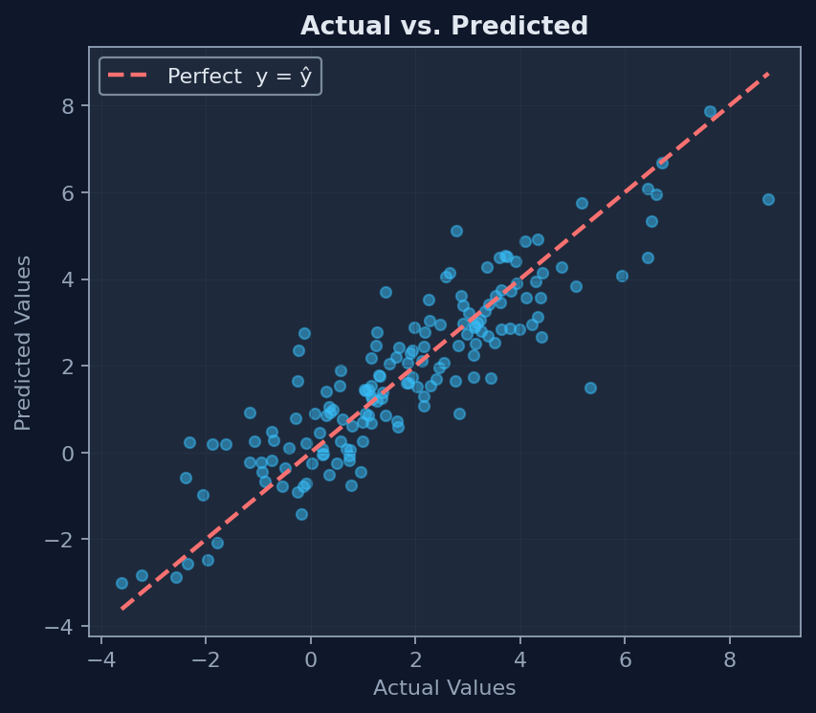
Open Minds Club
06. Actual vs. Predicted Plot
- x-axis: actual values, y-axis: predicted values
- A perfect model → all points on the diagonal line y = x
- Clusters away from the line reveal systematic errors

Slide 25
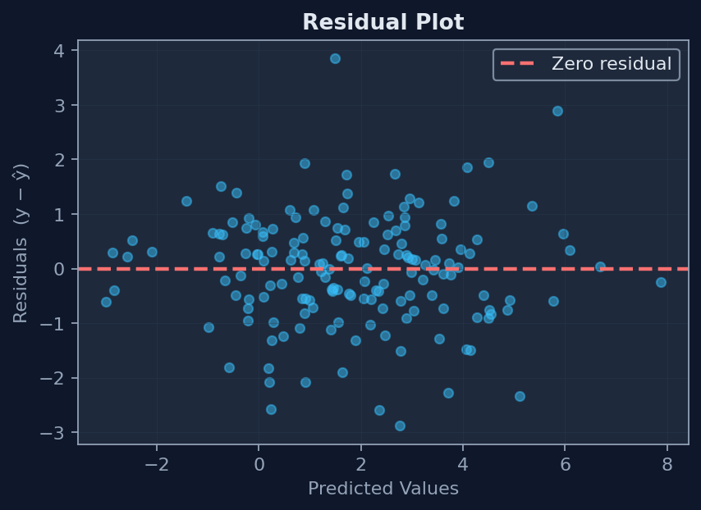
Open Minds Club
06. Residual Plot
- x-axis: predicted values, y-axis: residuals
- Good model → residuals scattered randomly around 0
- Patterns in this plot = your model is missing something

Slide 26
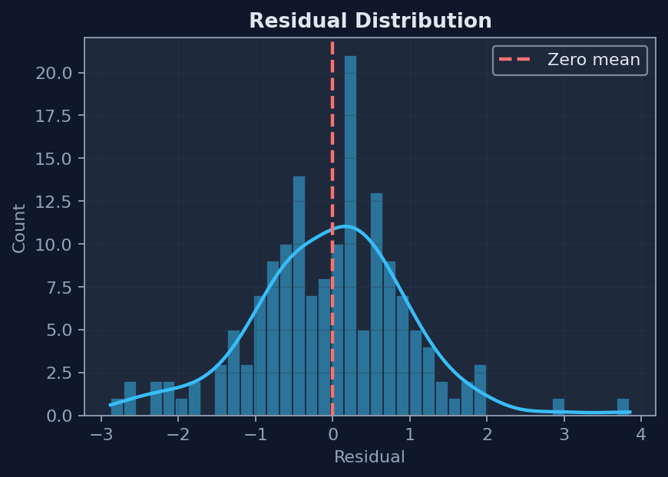
Open Minds Club
06. Residual Distribution Plot
- Histogram or KDE of residuals
- Should look roughly normal, centered at 0
- Skewed distribution → model has a bias

Slide 27
Open Minds Club
Numbers lie. Plots don't. Always visualize before concluding.
07. Bias–Variance Tradeoff

Slide 28
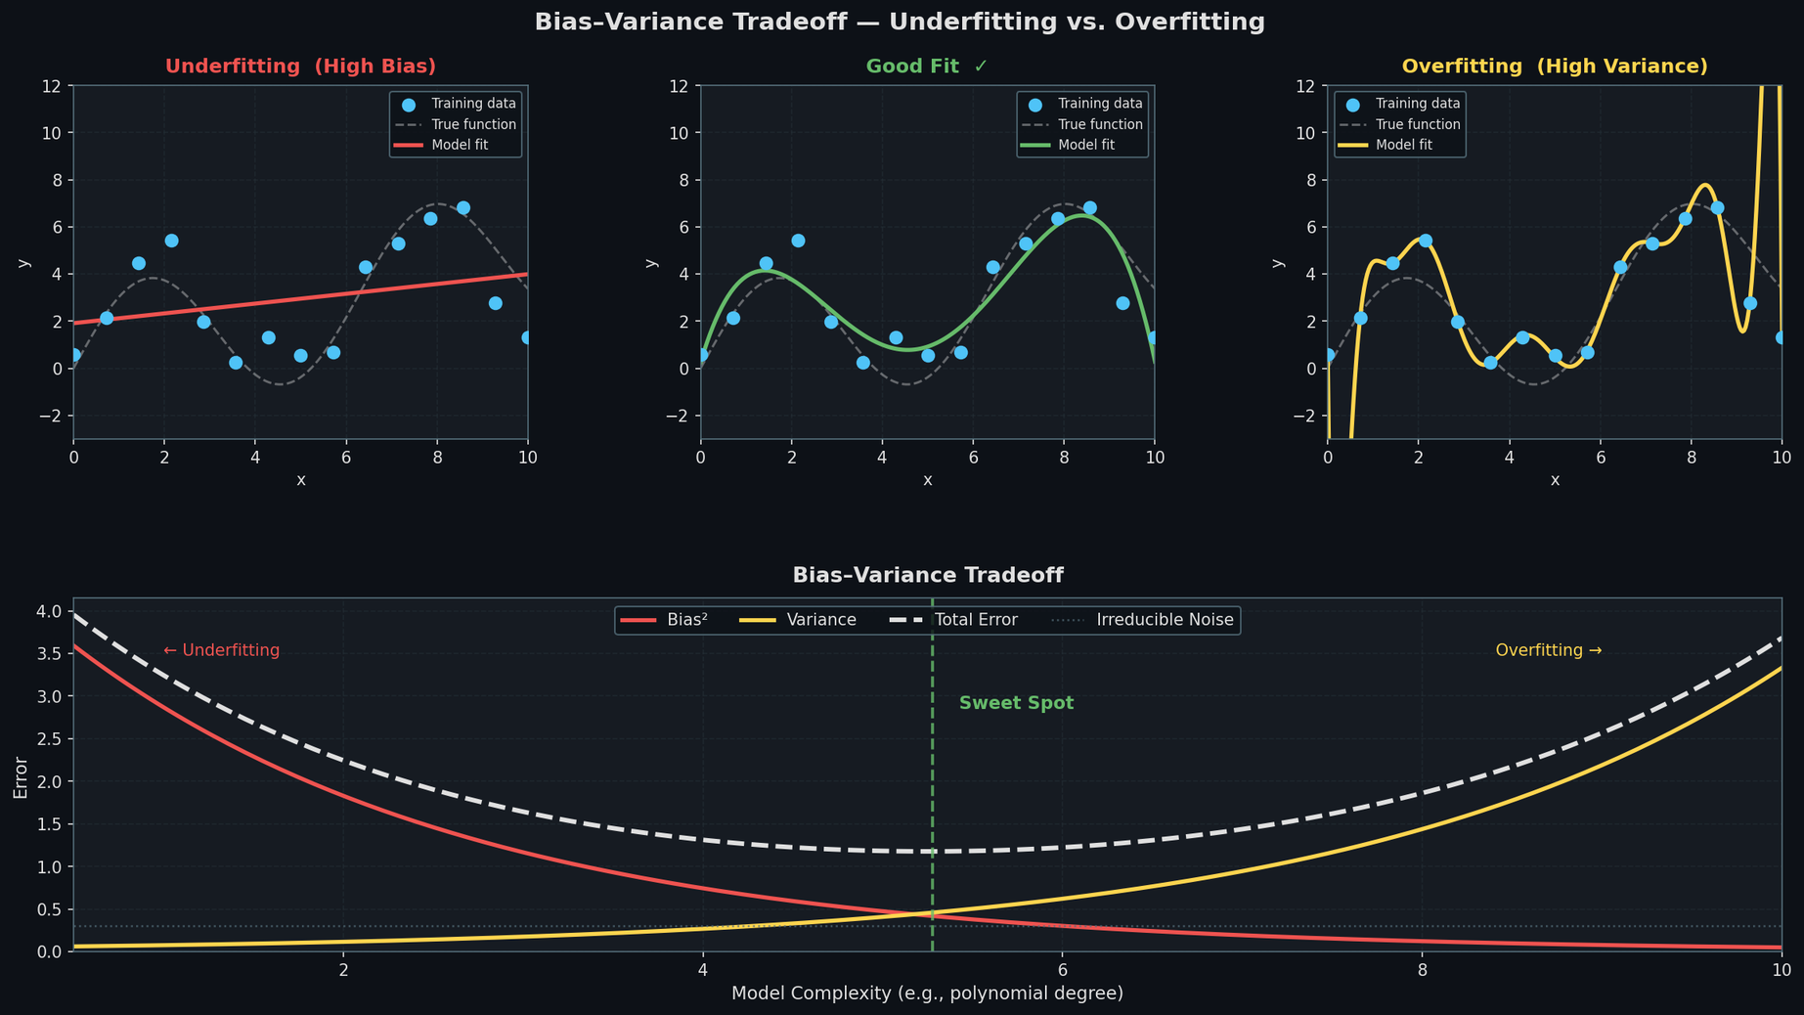
Open Minds Club
07. Bias-Variance Trade-off

Slide 29
Open Minds Club
07. Bias-Variance Trade-off
Bias => Underfitting | Variance => Overfitting
The model is too simple High bias → underfitting: misses the real pattern even on training data | The model is too complex High variance → overfitting: memorizes noise, fails on new data
Bad Performance on Both Train & Test (or Val) Sets Training error ≈ Test error (both high) → Underfitting → add complexity | Good Performance on Train X Bad Performance on Val/Test Training error low, Test error high → Overfitting → simplify or regularize / add data

Slide 30
Open Minds Club
08. Regularization: Ridge & Lasso

Slide 31
Open Minds Club
08. Regularization
Problem: When a linear regression model overfits, its coefficients grow very large.
Solution: Add a penalty term to the loss function that discourages large coefficients.

Slide 32
Open Minds Club
08. Ridge (L2)
Loss = MSE + λ · Σ βᵢ²
- Penalizes the square of each coefficient
- Shrinks all coefficients toward zero, but never exactly to zero
- Great when many features contribute a little
- Controlled by λ (lambda): larger λ → stronger shrinkage

Slide 33
Open Minds Club
08. Lasso Regression (L1)
Loss = MSE + λ · Σ |βᵢ|
- Penalizes the absolute value of each coefficient
- Can shrink coefficients all the way to zero → built-in feature selection
- Great when only a few features actually matter

Slide 34

Open Minds Club
Any Questions ?

Slide 35
Open Minds Club
Thank you for your attention ✨

